Slide 1

332:479 Concepts in VLSI
Design
Lecture 18
SRAM
David Harris and Mike Bushnell
Harvey Mudd College and Rutgers University
Spring 2004

Slide 2
Outline
Memory Arrays
SRAM Architecture
  SRAM Cell
  Decoders
  Column Circuitry
  Multiple Ports
Serial Access Memories
Summary

Slide 3
Material from: CMOS VLSI Design
By Neil E. Weste and David Harris
and
VLSI Engineering
By Thomas E. Dillinger

Slide 4
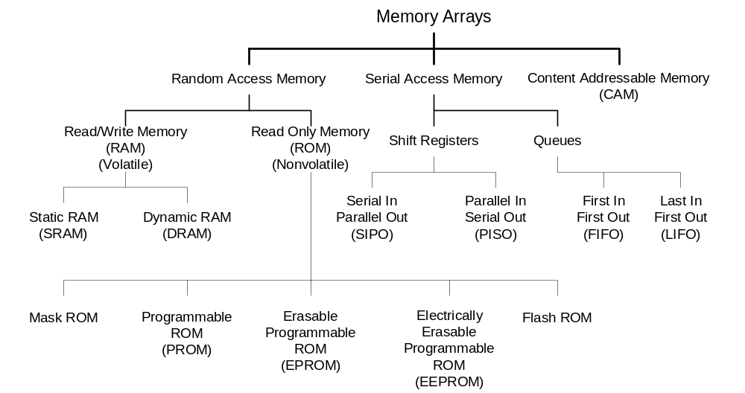
Memory Arrays

Slide 5
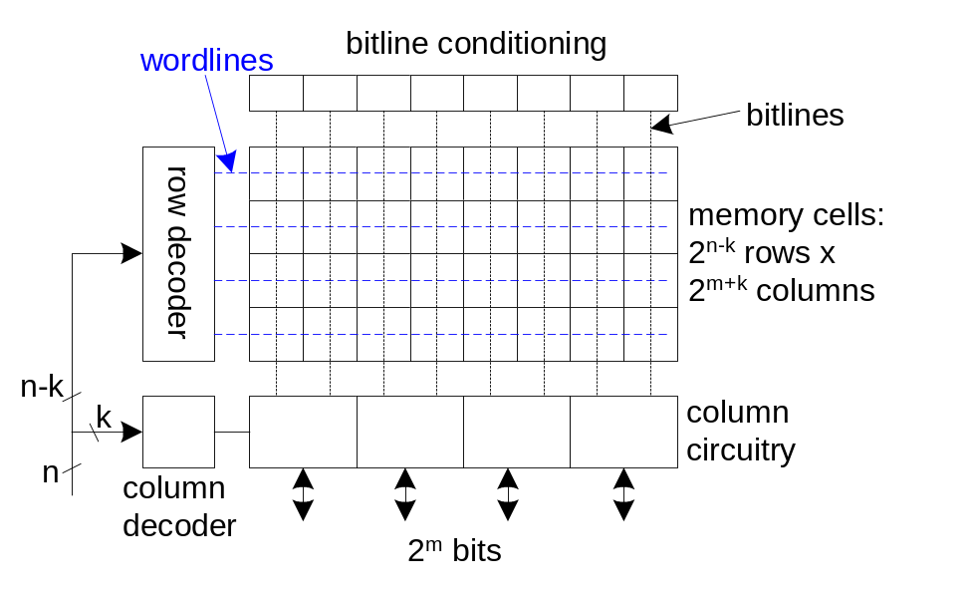
Array Architecture
2^{n} words of 2^{m} bits each
If n >> m, fold by 2^{k} into fewer rows of more columns
Good regularity – easy to design
Very high density if good cells are used

Slide 6
RAM vs. ROM
RAM
  Access time independent of physical data location
  Similar read & write times
ROM
  Write time (msec) >>> read time
Static RAMS
  Faster but much larger cells than DRAMs
CMOS ASICs competitive with high-speed static memories in density
Not competitive with off-the-shelf DRAMs

Slide 7
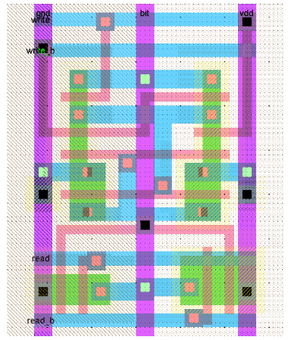
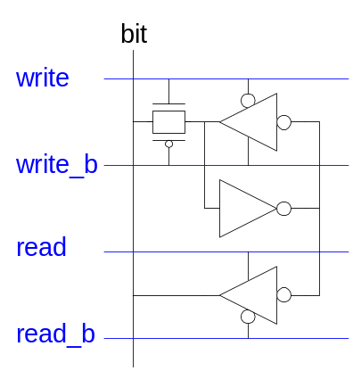
12T SRAM Cell
Basic building block: SRAM Cell
  Holds one bit of information, like a latch
  Must be read and written
12-transistor (12T) SRAM cell
  Use a simple latch connected to bitline
  46 x 75 λ unit cell

Slide 8
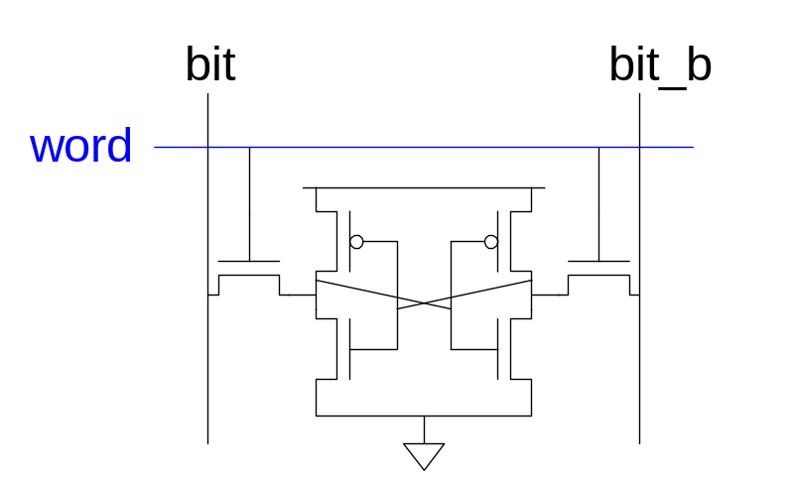
6T SRAM Cell
Cell size accounts for most of array size
  Reduce cell size at expense of complexity
6T SRAM Cell
  Used in most commercial chips
  Data stored in cross-coupled inverters
Read:
  Precharge bit, bit_b
  Raise wordline
Write:
  Drive data onto bit, bit_b
  Raise wordline

Slide 9
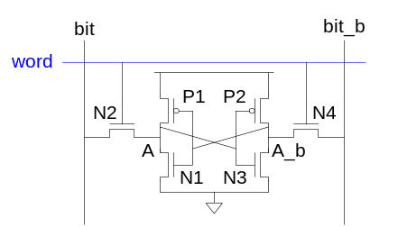
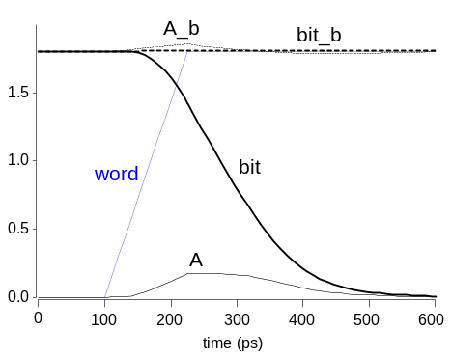
SRAM Read
Precharge both bitlines high
Then turn on wordline
One of the two bitlines will be pulled down by the cell
Ex: A = 0, A_b = 1
  bit discharges, bit_b stays high
  But A bumps up slightly
Read stability
  A must not flip

Slide 10
SRAM Read
Precharge both bitlines high
Then turn on wordline
One of the two bitlines will be pulled down by the cell
Ex: A = 0, A_b = 1
  bit discharges, bit_b stays high
  But A bumps up slightly
Read stability
  A must not flip
  N1 >> N2

Slide 11
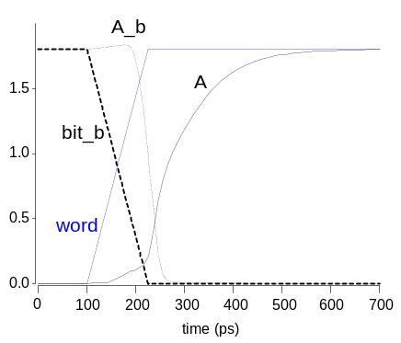
SRAM Write
Drive one bitline high, the other low
Then turn on wordline
Bitlines overpower cell with new value
Ex: A = 0, A_b = 1, bit = 1, bit_b = 0
  Force A_b low, then A rises high
Writability
  Must overpower feedback inverter
If using poly resistors as pullups to save power,
R = 100’s to 1000’s of MΩ

Slide 12
SRAM Write
Drive one bitline high, the other low
Then turn on wordline
Bitlines overpower cell with new value
Ex: A = 0, A_b = 1, bit = 1, bit_b = 0
  Force A_b low, then A rises high
Writability
  Must overpower feedback inverter
  N2 >> P1

Slide 13
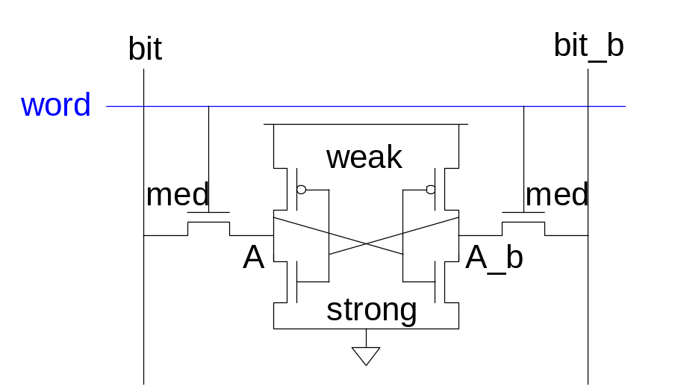
SRAM Sizing
High bitlines must not overpower inverters during reads
But low bitlines must write new value into cell

Slide 14
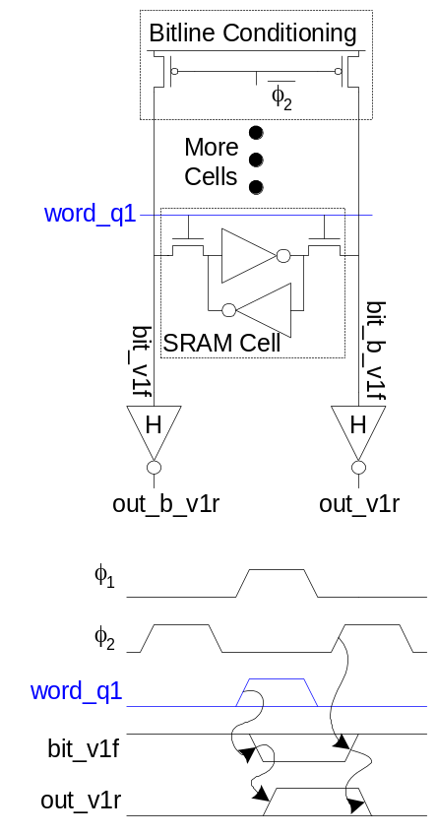
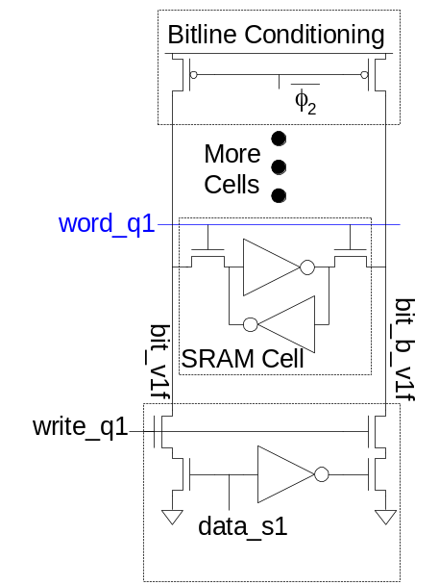
SRAM Column Example
Read Write

Slide 15
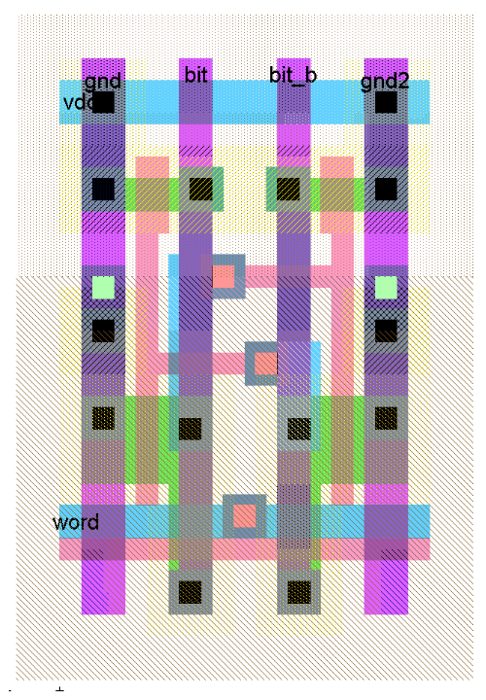
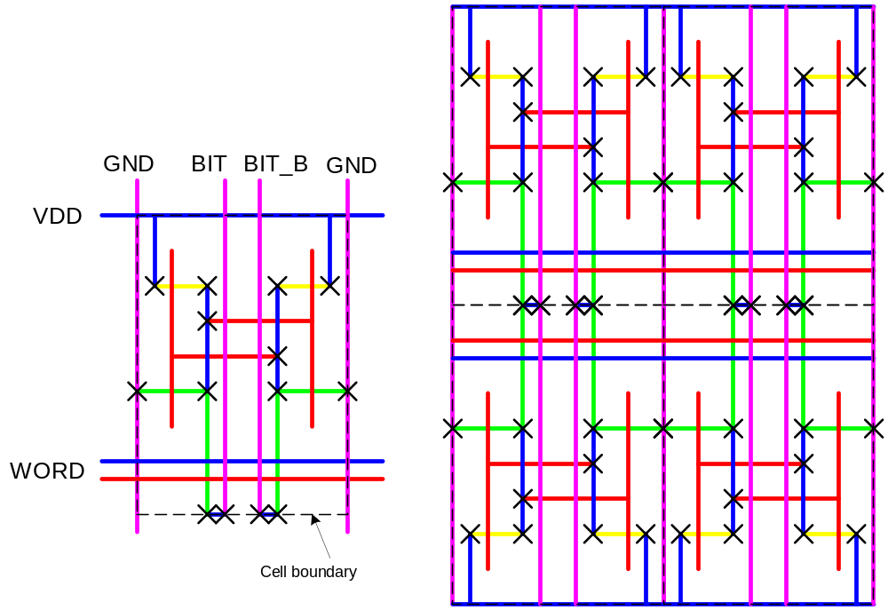
SRAM Layout
Cell size is critical: 26 x 45 λ (even smaller in industry)
Tile cells sharing V_{DD}, GND, bitline contacts

Slide 16
Reduced Power SRAM
Improve access speed by using n transistors to precharge bit, bit to V_{DD} – V_{tn} or by precharging only to V_{DD} / 2
  Reduces power dissipation
Avoid asserting WORD line before end of precharge, or bit lines may flip the RAM cell state

Slide 17
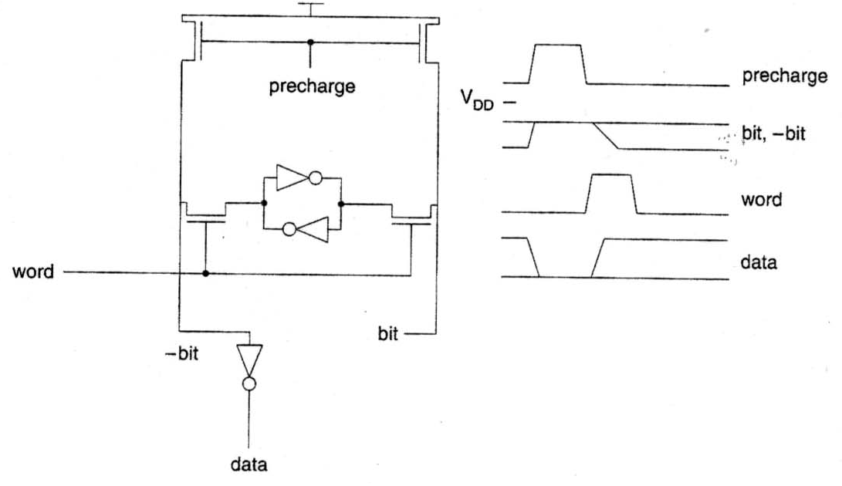
Reduced-Power SRAM Cell

Slide 18
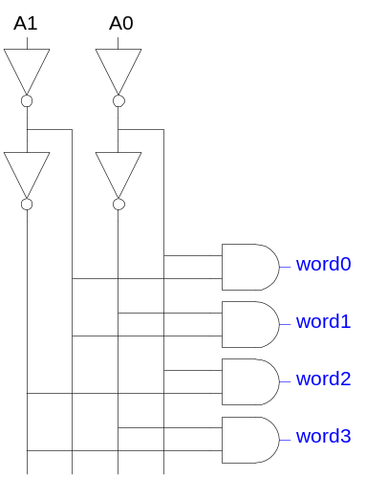
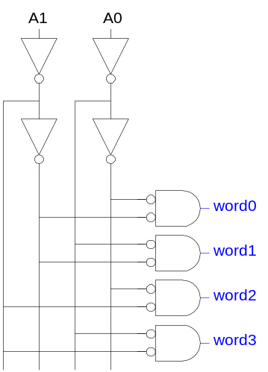
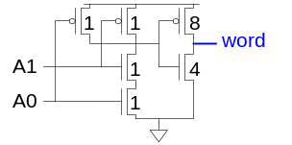
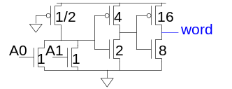
Decoders
n:2^{n} decoder consists of 2^{n} n-input AND gates
  One needed for each row of memory
  Build AND from NAND or NOR gates
Make devices on address line minimal size
Scale devices on decoder O/P to drive word lines
Static CMOS Pseudo-nMOS

Slide 19
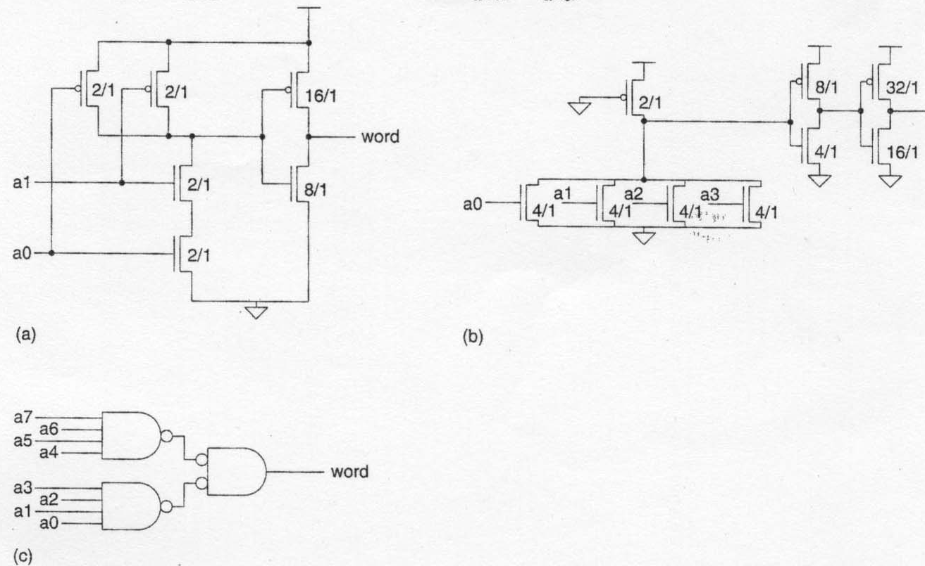
Row Decoders

Slide 20
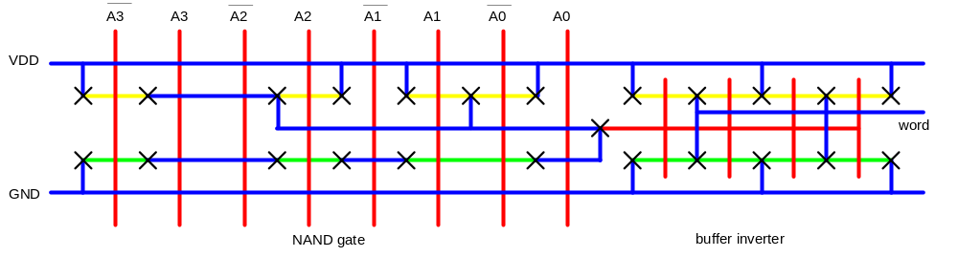
Decoder Layout
Decoders must be pitch-matched to SRAM cell
  Requires very skinny gates

Slide 21
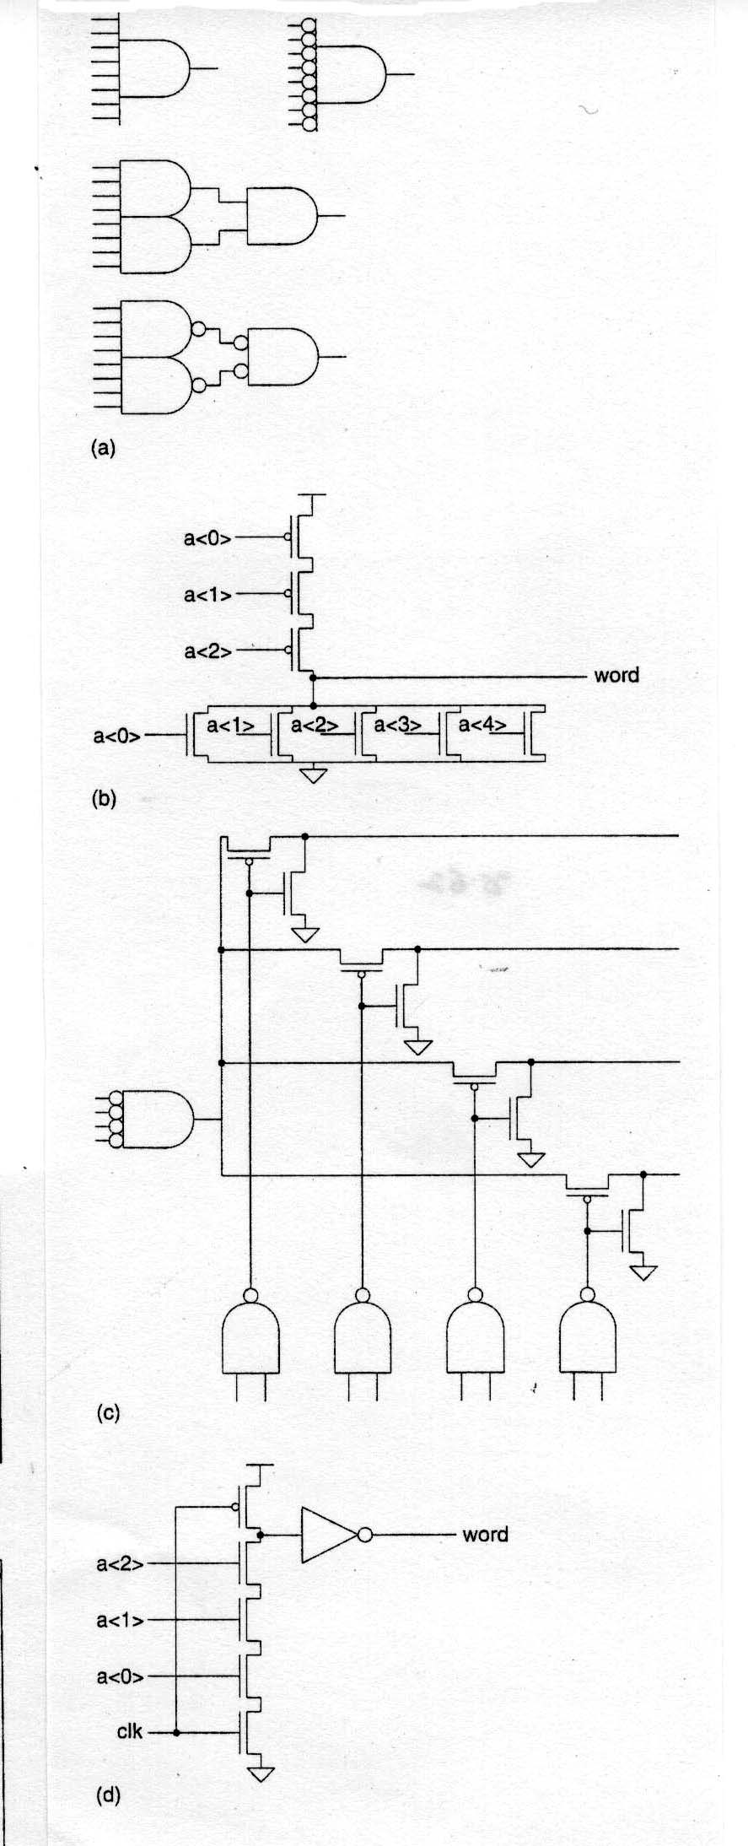
Decoder Designs

Slide 22
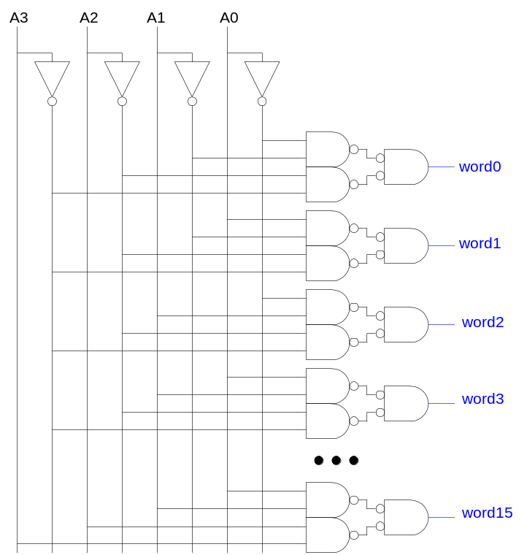
Large Decoders
For n > 4, NAND gates become slow
  Break large gates into multiple smaller gates

Slide 23
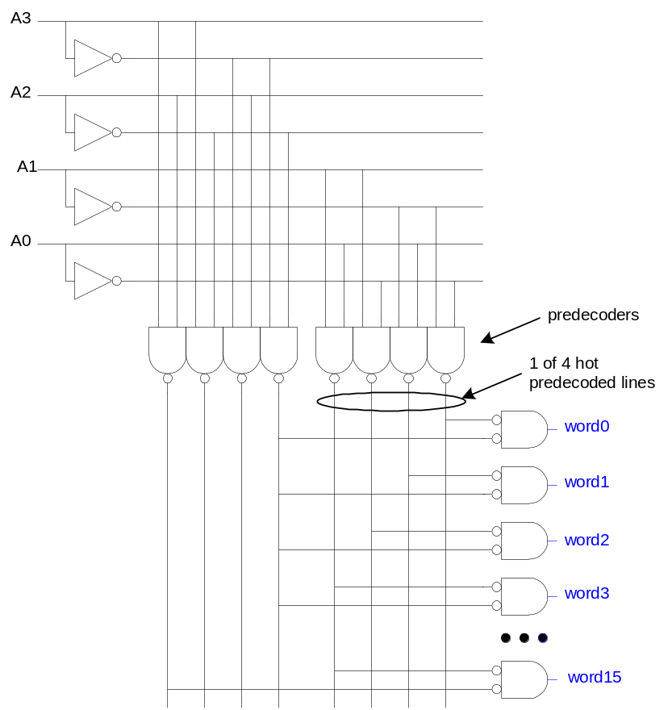
Predecoding
Many of these gates are redundant
  Factor out common
  gates into predecoder
  Saves area
  Same path effort

Slide 24
Column Circuitry
Some circuitry is required for each column
  Bitline conditioning
  Sense amplifiers
  Column multiplexing
Need hazard-free reading & writing of RAM cell
Column decoder drives a MUX – the two are often merged

Slide 25
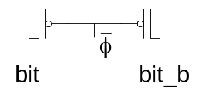
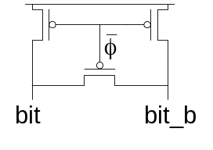
Bitline Conditioning
Precharge bitlines high before reads
Equalize bitlines to minimize voltage difference when using sense amplifiers

Slide 26
Sense Amplifiers
Bitlines have many cells attached
  Ex: 32-kbit SRAM has 256 rows x 128 cols
  128 cells on each bitline
t_{pd} ∝ (C/I) ΔV
  Even with shared diffusion contacts, 64C of diffusion capacitance (big C)
  Discharged slowly through small transistors (small I)
Sense amplifiers are triggered on small voltage swing (reduce ΔV)

Slide 27
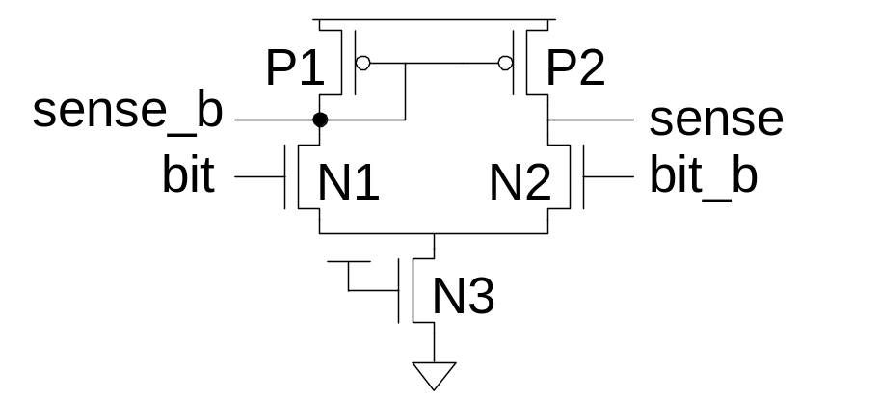
Differential Pair Amp
Differential pair requires no clock
But always dissipates static power
Not useful for DRAM write-back cycle
If addresses change after precharge, multiple cells switch onto bit & bit and confuse the sense amp.
Do not use

Slide 28
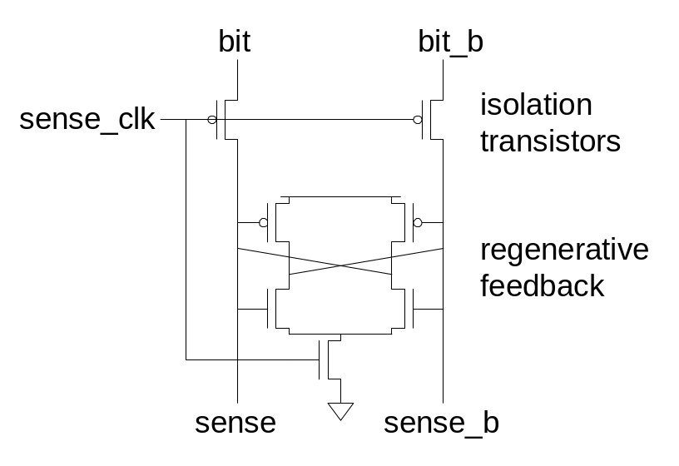
Better Clocked Sense Amp
Clocked sense amp saves power
Requires sense_clk after enough bitline swing
Isolation transistors cut off large bitline capacitance

Slide 29
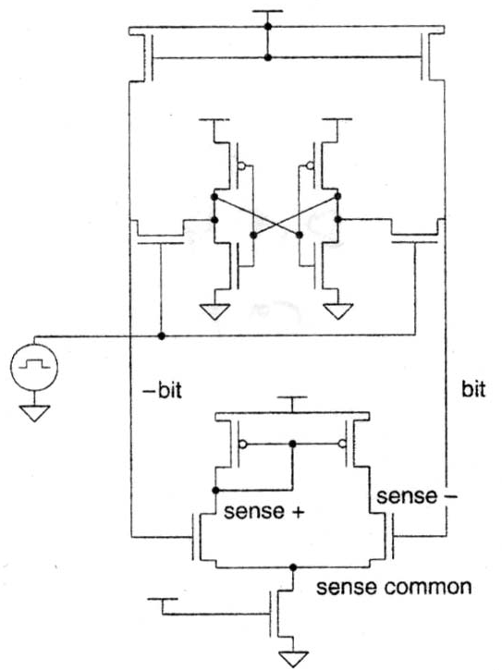
Non-Precharge RAM Cell Read Operation
Use differential amplifier to magnify line difference

Slide 30
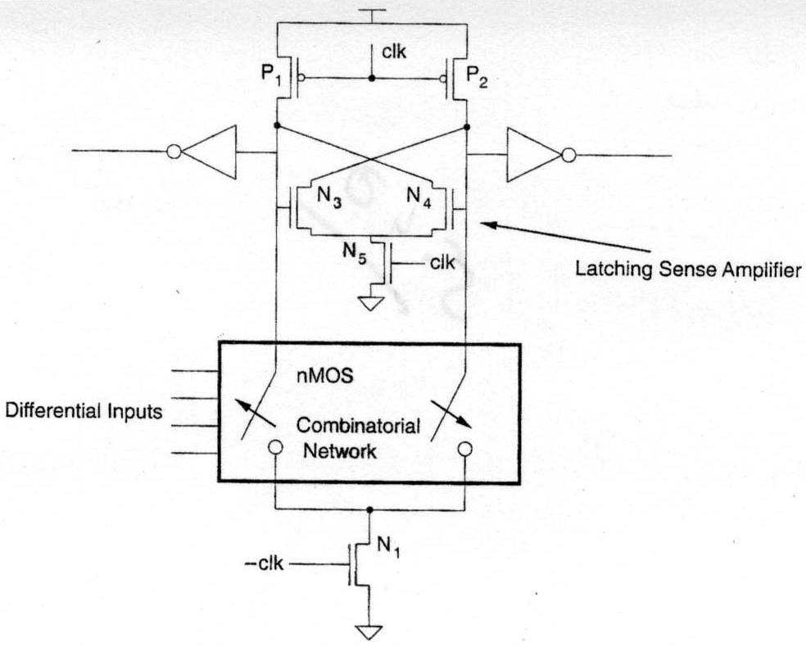
Latching Sense Amplifier
Use!

Slide 31
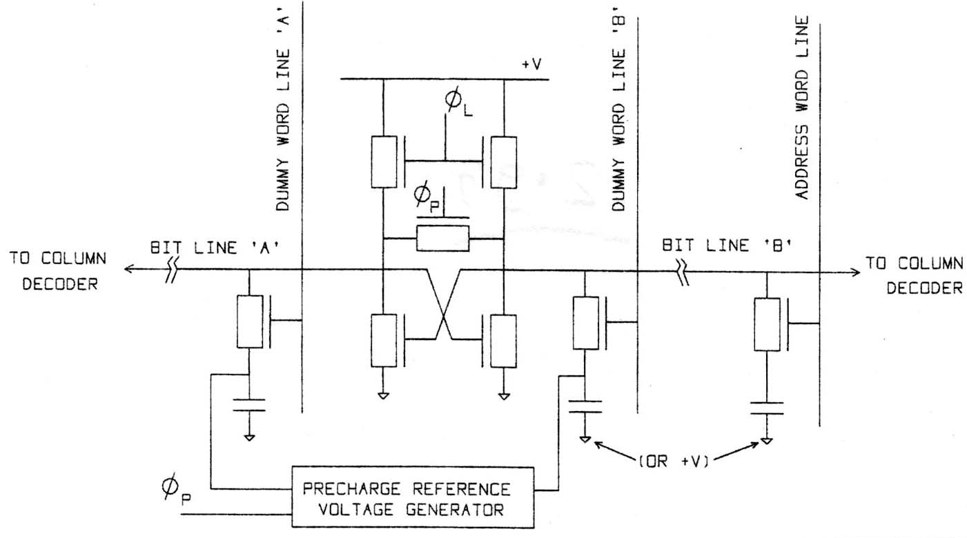
Gated Flip-Flop Sense Amp.

Slide 32
Gated Flip-Flop Sense Amp.
Use dummy cell on ½ of amplifier not in use
Use most significant row address bit to select dummy cell
Best for write-back after destructive read-out

Slide 33
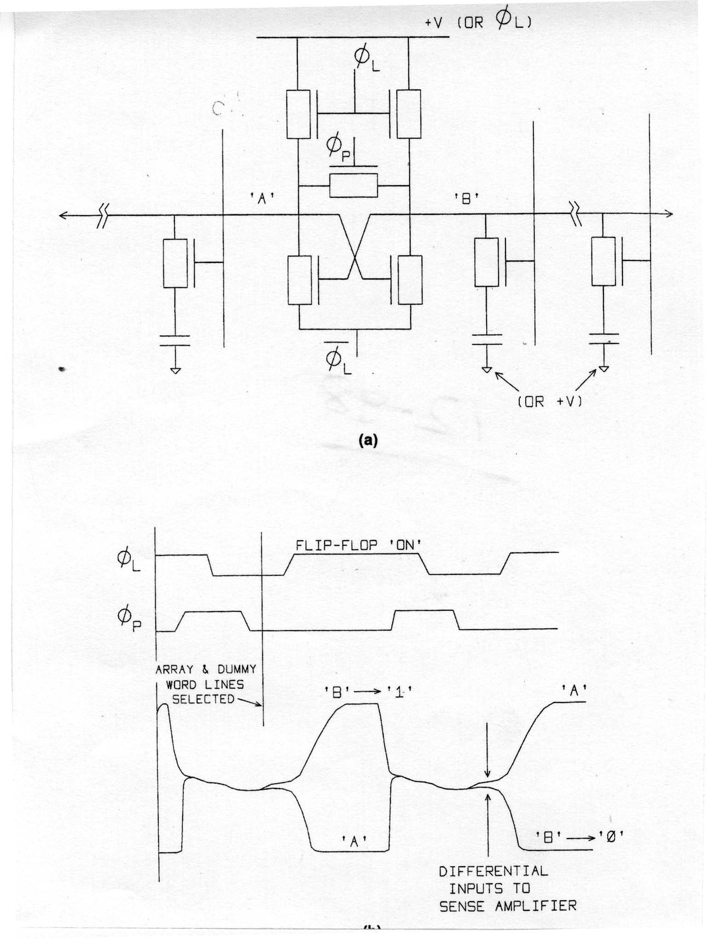
Best Sense Amplifier

Slide 34
Sense Amplifier Timing

Slide 35
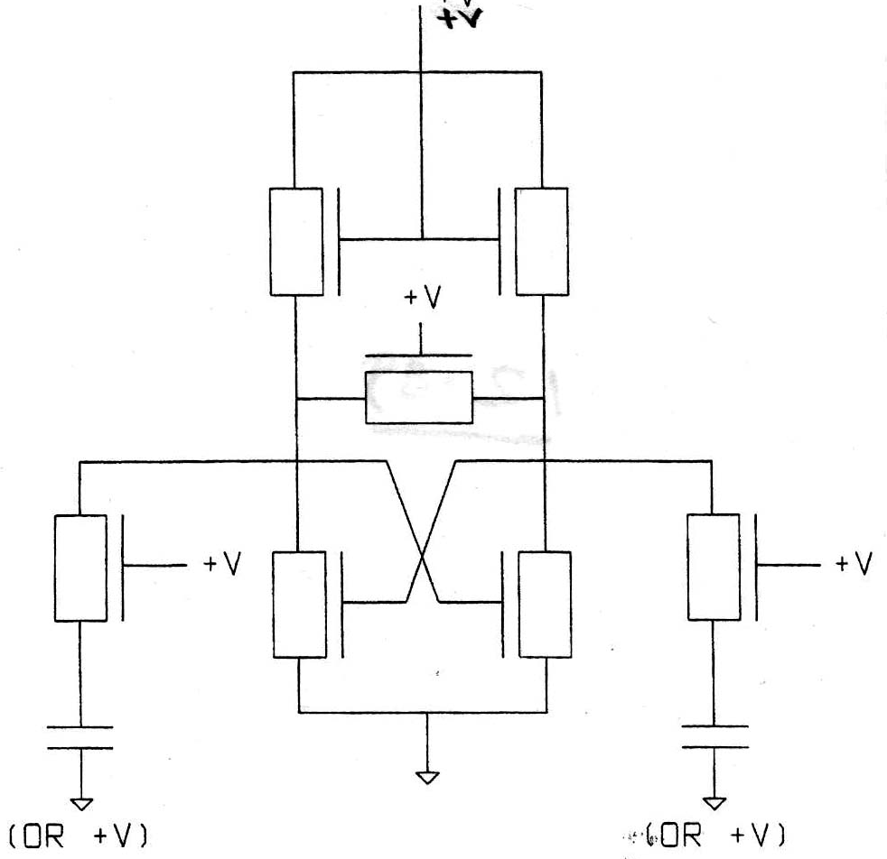
Sense Amplifier Circuit

Slide 36
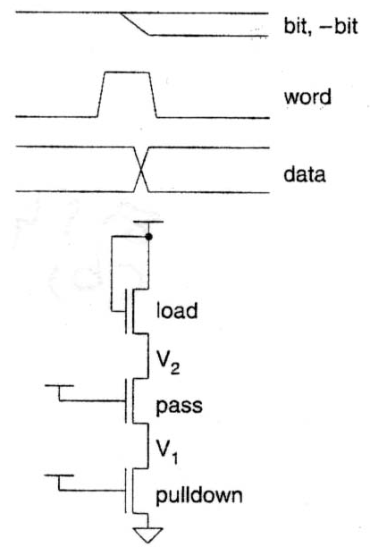
Pulldown Transistor Circuit
Make V₁ clear V_{tn} of RAM cell inverters – 0.5 to 1 V
V₂ gives BIT line difference – amplify this

Slide 37
SRAM Transistor Sizing
0 BIT line V and pulldown voltage
Weaken pullup, then V_{BIT} (0) V_{SS}
  Increases difference between high & low on BIT lines
  But – increases pulldown size – bad for density

Slide 38
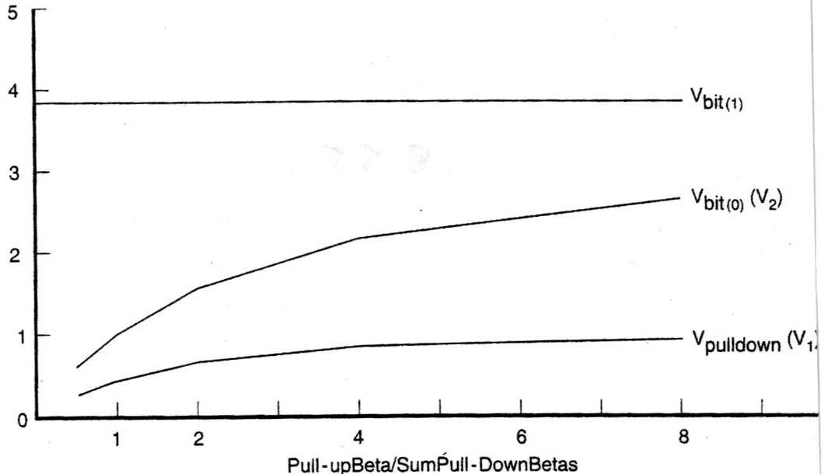
Cell Electrical Design
RAM bit-line voltage vs. transistor size for SRAM

Slide 39
RAM Cell Equations
{
}
V₂ = (V_{DD} – V_{tn}) 1 – 1
1 + β_{pullup}
β_{driver-eff}
β_{driver-eff} = β of series pass & pull-down transistors
V₁ -- resistive divider action between word transistor and pull-down
Linear region: V₁ = V₂ β_{pass}
β_{pass} + β_{pull-down}

Slide 40
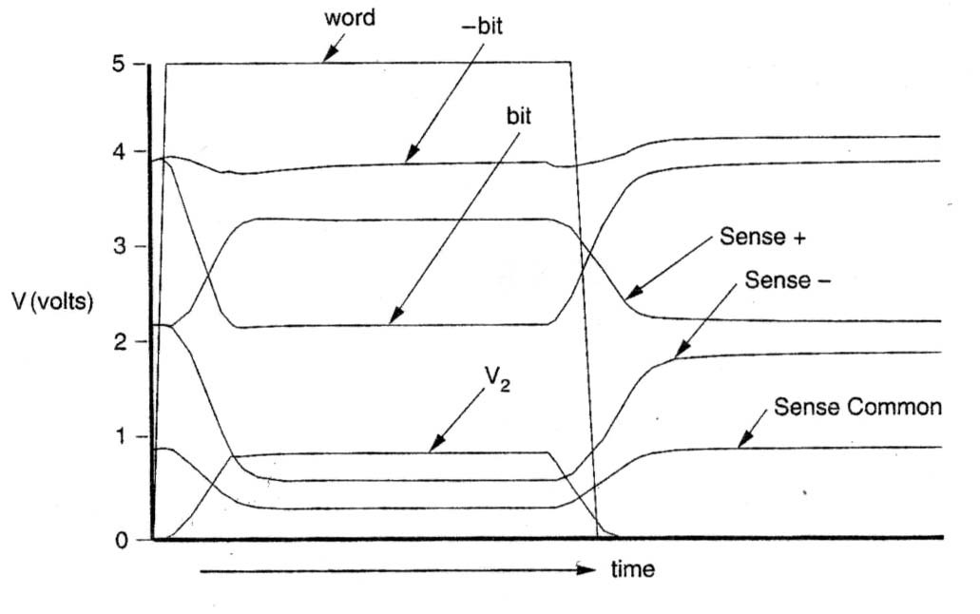
Waveforms & Correct Usage

Slide 41
Timing Waveforms for Write Drivers & Write Operation
Can also use current mode sensing on sense lines
Recovery time – interval between word deassertion and BIT = BIT

Slide 42
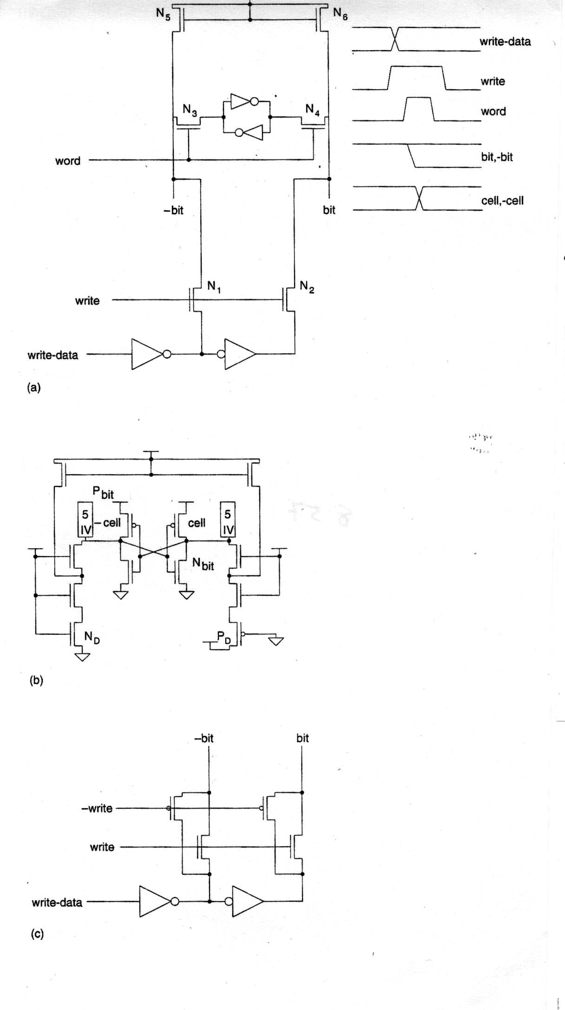
Write Driver Circuits

Slide 43
Circuit Model for Writing

Slide 44
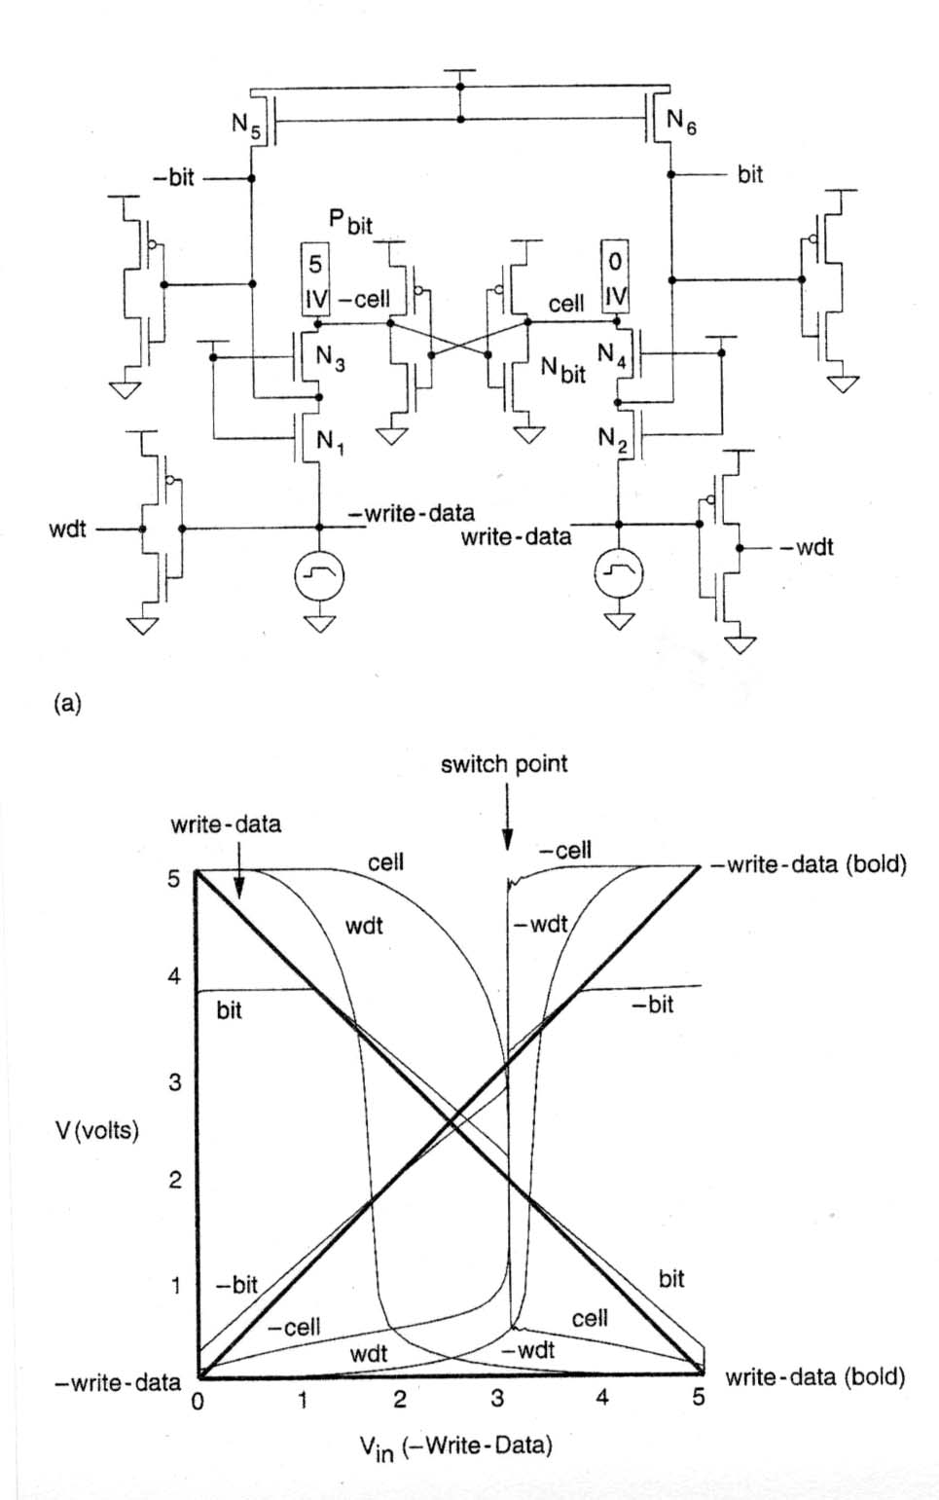
Circuit for Finding Timing Waveforms

Slide 45
Write Timing Waveforms

Slide 46
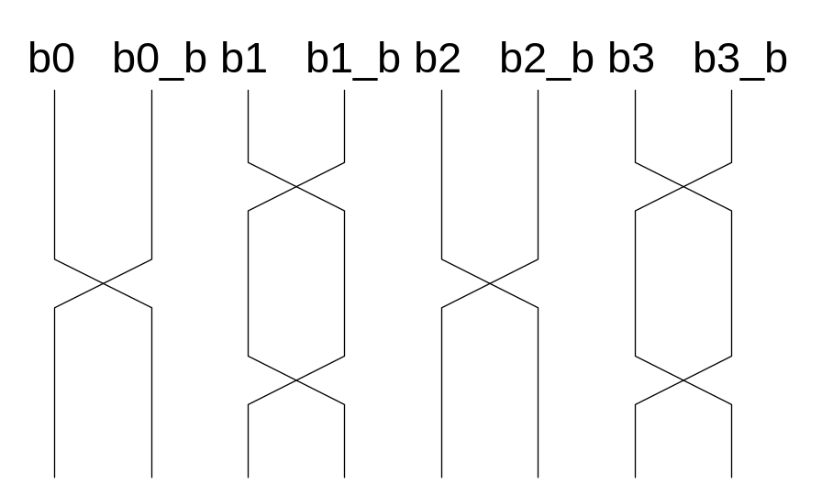
Twisted Bitlines
Sense amplifiers also amplify noise
  Coupling noise is severe in modern processes
  Try to couple equally onto bit and bit_b
  Done by twisting bitlines

Slide 47
Column Multiplexing
Recall that array may be folded for good aspect ratio
Ex: 2 kword x 16 folded into 256 rows x 128 columns
  Must select 16 output bits from the 128 columns
  Requires 16 8:1 column multiplexers

Slide 48
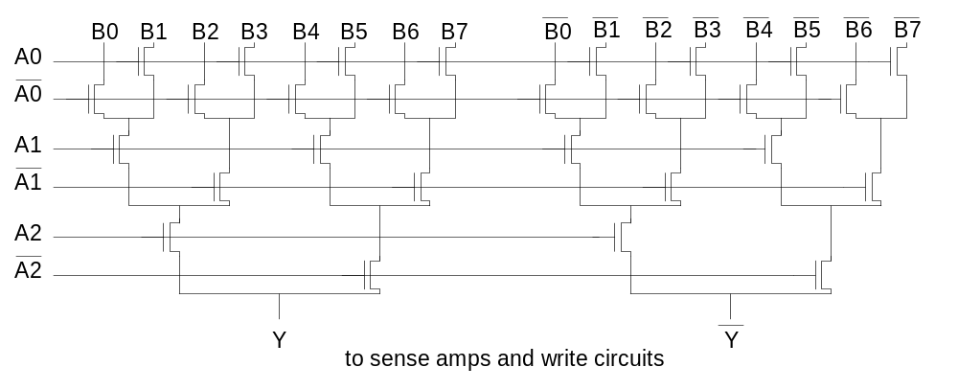
Tree Decoder Mux
Column MUX can use pass transistors
  Use nMOS only, precharge outputs
One design is to use k series transistors for 2^{k}:1 mux
  No external decoder logic needed

Slide 49
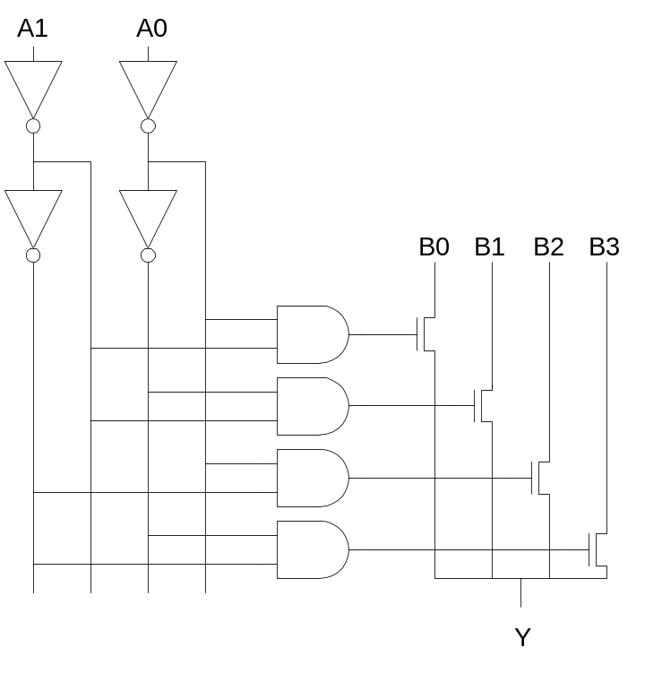
Single Pass-Gate Mux
Or eliminate series transistors with separate decoder

Slide 50
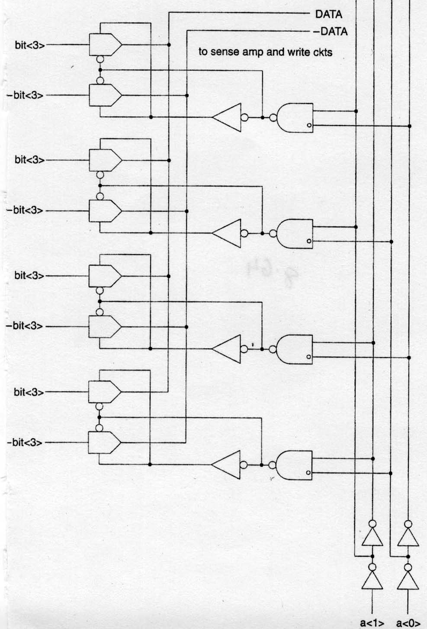
Decoded Column Decoder
Reduces series transistor delay

Slide 51
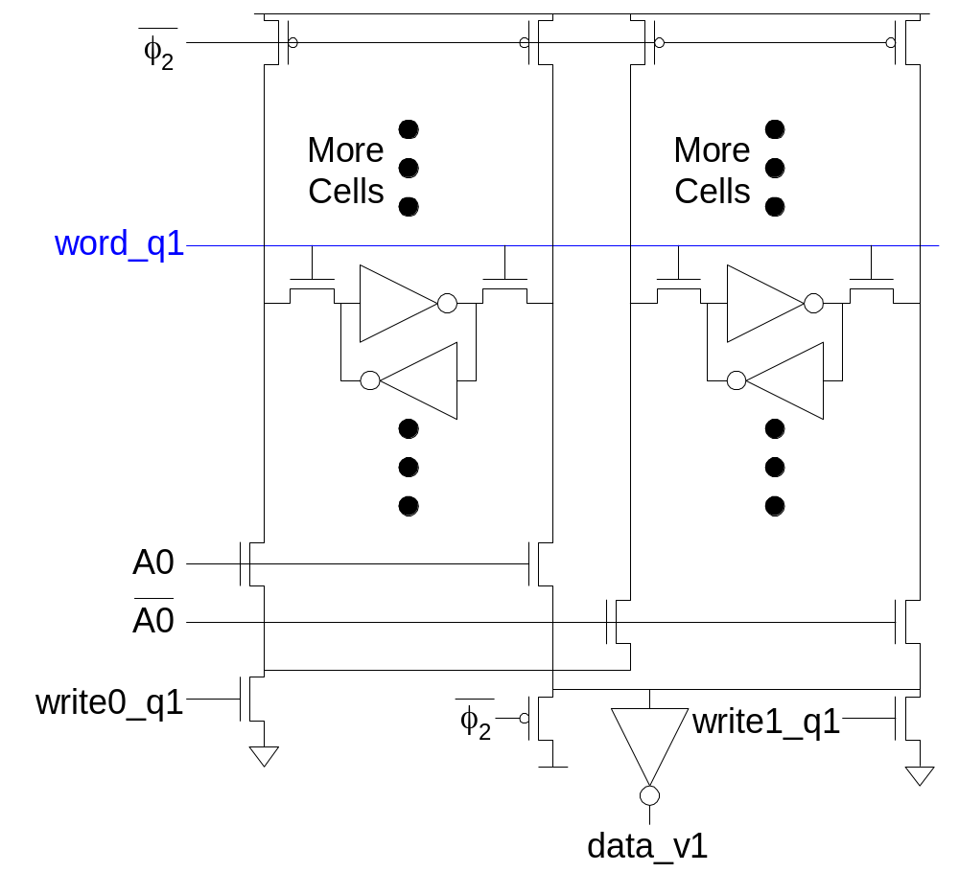
Ex: 2-way MUXed SRAM

Slide 52
Multiple Ports
We have considered single-ported SRAM
  One read or one write on each cycle
Multiported SRAM are needed for register files
Examples:
  Multicycle MIPS must read two sources or write a result on some cycles
  Pipelined MIPS must read two sources and write a third result each cycle
  Superscalar MIPS must read and write many sources and results each cycle

Slide 53
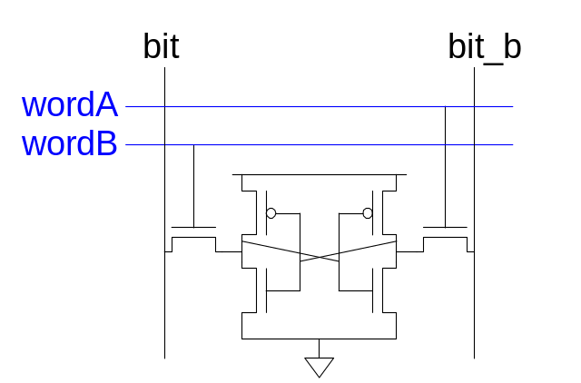
Dual-Ported SRAM
Simple dual-ported SRAM
  Two independent single-ended reads
  Or one differential write
Do two reads and one write by time multiplexing
  Read during φ1, write during φ2

Slide 54
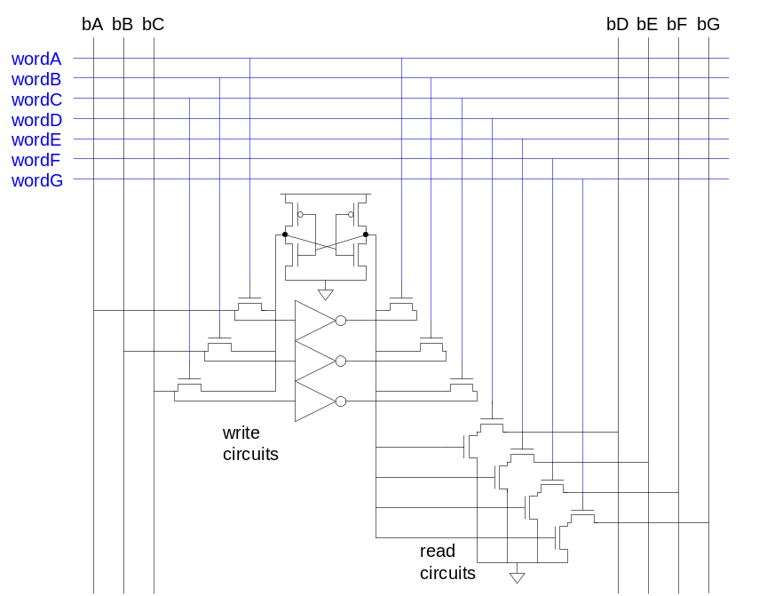
Multi-Ported SRAM
Adding more access transistors hurts read stability
Multiported SRAM isolates reads from state node
Single-ended design minimizes number of bitlines

Slide 55
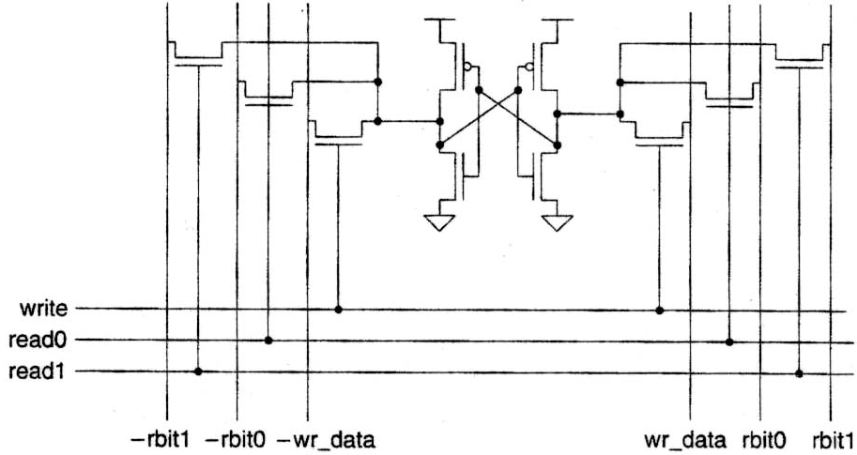
Register File

Slide 56
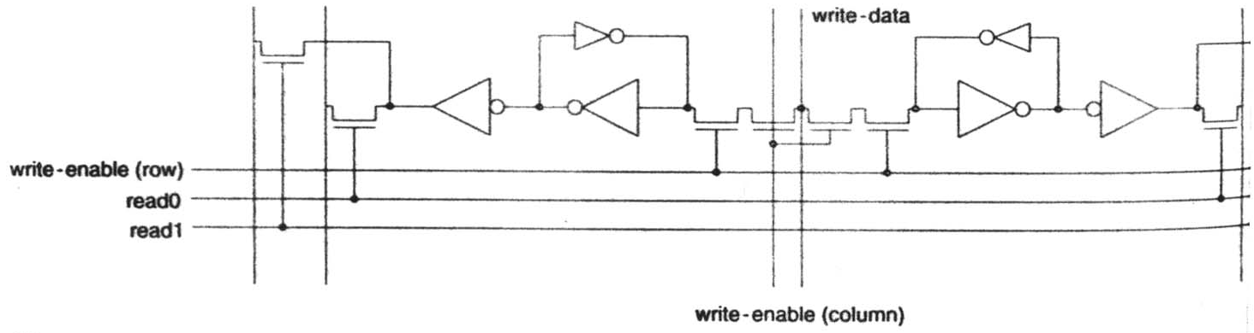
Multi-Port Register File
Single write port, double read port
Fast RAM with multiple read/write ports
Read cells need not be differential

Slide 57
Serial Access Memories
Serial access memories do not use an address
  Shift Registers
  Tapped Delay Lines
  Serial In Parallel Out (SIPO)
  Parallel In Serial Out (PISO)
  Queues (FIFO, LIFO)

Slide 58
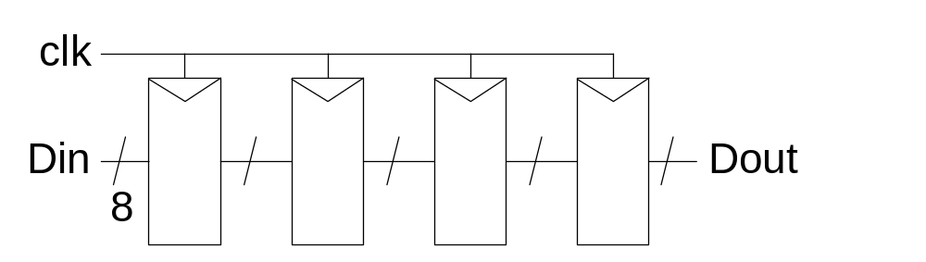
Shift Register
Shift registers store and delay data
Simple design: cascade of registers
  Watch your hold times!

Slide 59
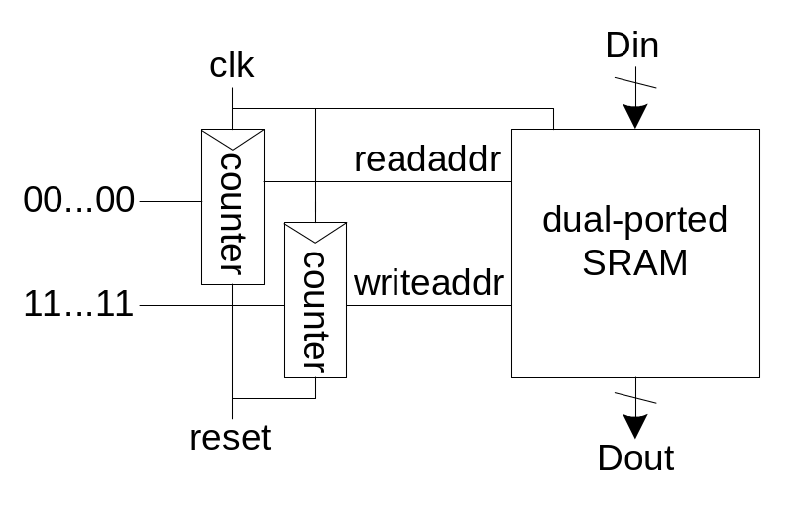
Denser Shift Registers
Flip-flops aren’t very area-efficient
For large shift registers, keep data in SRAM instead
Move read/write pointers to RAM rather than data
  Initialize read address to first entry, write to last
  Increment address on each cycle

Slide 60
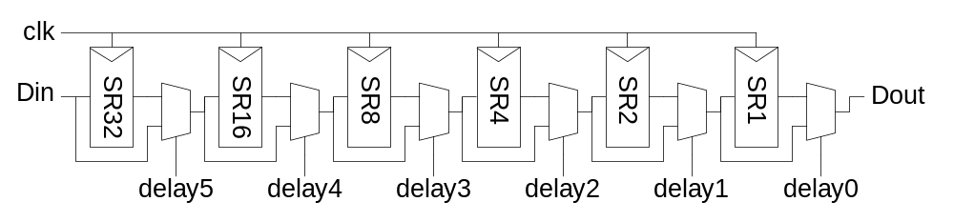
Tapped Delay Line
A tapped delay line is a shift register with a programmable number of stages
Set number of stages with delay controls to mux
  Ex: 0 – 63 stages of delay

Slide 61
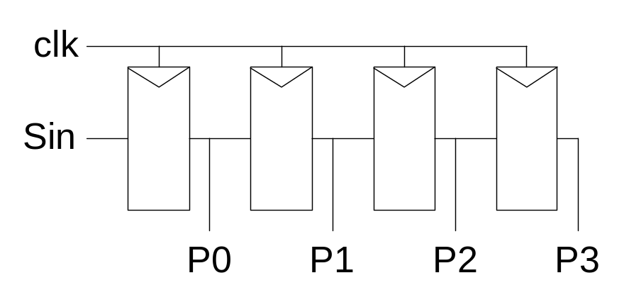
Serial In Parallel Out
1-bit shift register reads in serial data
  After N steps, presents N-bit parallel output

Slide 62

Parallel In Serial Out
Load all N bits in parallel when shift = 0
  Then shift one bit out per cycle

Slide 63

Queues
Queues allow data to be read and written at different rates.
Read and write each use their own clock, data
Queue indicates whether it is full or empty
Build with SRAM and read/write counters (pointers)

Slide 64
FIFO, LIFO Queues
First In First Out (FIFO)
  Initialize read and write pointers to first element
  Queue is EMPTY
  On write, increment write pointer
  If write almost catches read, Queue is FULL
  On read, increment read pointer
Last In First Out (LIFO)
  Also called a stack
  Use a single stack pointer for read and write

Slide 65

FIFO
Buffers data between asynchronous data streams
Can add Almost-Full & Almost-Empty flags
Simplest Implementation – dual port RAM register file and read & write counters

Slide 66

FIFO Cells

Slide 67
FIFO Cell

Slide 68
LIFO Memory
Push-down stack
Use regular register file
Use a distributed ROW decoder to save space (harder to design)

Slide 69
Summary
Memory Arrays
SRAM Architecture
  SRAM Cell
  Decoders
  Column Circuitry
  Multiple Ports
Serial Access Memories

